Slide 1
P230-Patients Condition Classification Using Drug Reviews
Presented By Group 2:
Anitharani Y
Ankita Patjoshi
Hemant Kumar B K
Kavya D S
Sanjay Kumar T
Shreyas R
Soham Dilip Jadhav
Mentor:Mr.Madishetti Rajshekar

Slide 2
Contents:CC
Bussiness Objective
Data collection
Exploratory Data analysis
Visualizations
Data Preprocessing
Model building
Deployment

Slide 3
Business Objective:
• This is a sample dataset which consists of 161297 drug name, condition reviews and ratings from different patients and our goal is to examine how patients are feeling using the drugs their positive and negative experiences so that we can recommend him a suitable drug. By analysing the reviews, we can understand the drug effectiveness and its side effects.
• The dataset provides patient reviews on specific drugs along with related conditions and a 10 star patient rating reflecting overall patient satisfaction. So in this dataset, we can see many patients conditions but we will focus only on the below, classify the below conditions from the patients reviews
a) Depression b) High Blood Pressure c) Diabetes, Type 2

Slide 4
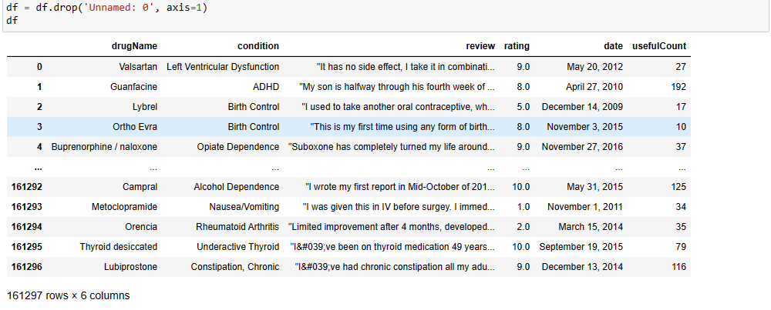
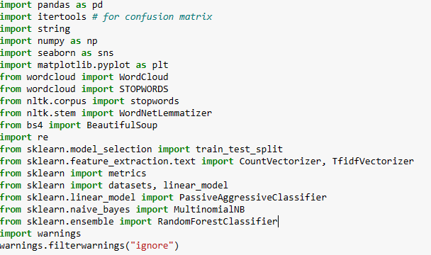
Importing libraries and Dataset

Slide 5
Data Description:
• 161297 Rows and 7 Columns
Attribute Information:
1. DrugName (categorical): name of drug
2. condition (categorical): name of condition
3. review (text): patient review
4. rating (numerical): 10 star patient rating
5. date (date): date of review entry
6. usefulCount (numerical): number of users who found review usefu

Slide 6
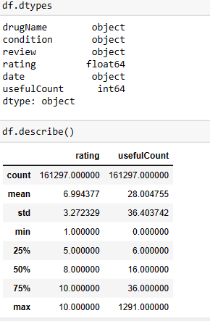
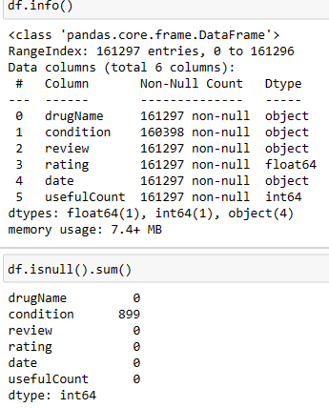
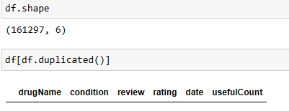
Exploratory Data Analysis(EDA)

Slide 7
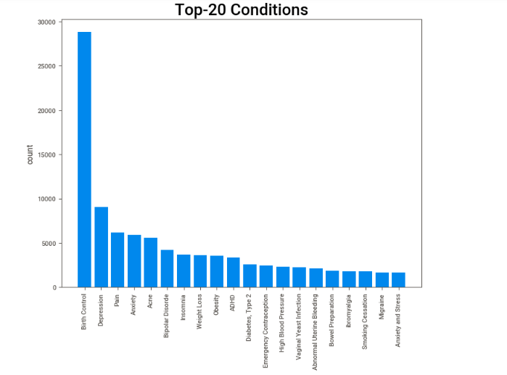
EDA Visualizations
From the above graph we can see Birth Control is twice as anyone,
Most of the top 20 Conditons are between 5000 - 10000

Slide 8
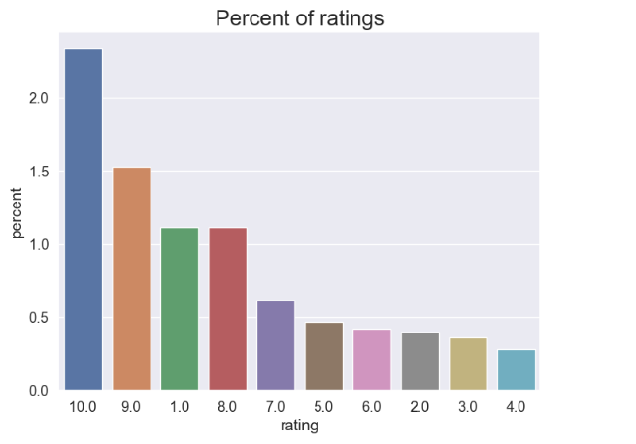
We notice that most of the ratings are high with ratings 10 and 9. rating 1 is also high which shows the extreme ratings of the user. We can say that the users mostly prefer to rate when the drugs are either very useful to them or the drugs fails, or there is some side effects. About 70% of the values have rating greater than 7.

Slide 9
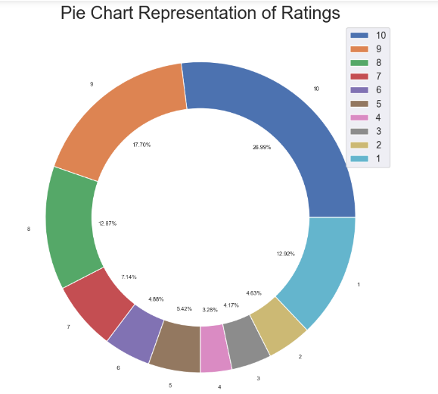

Slide 10
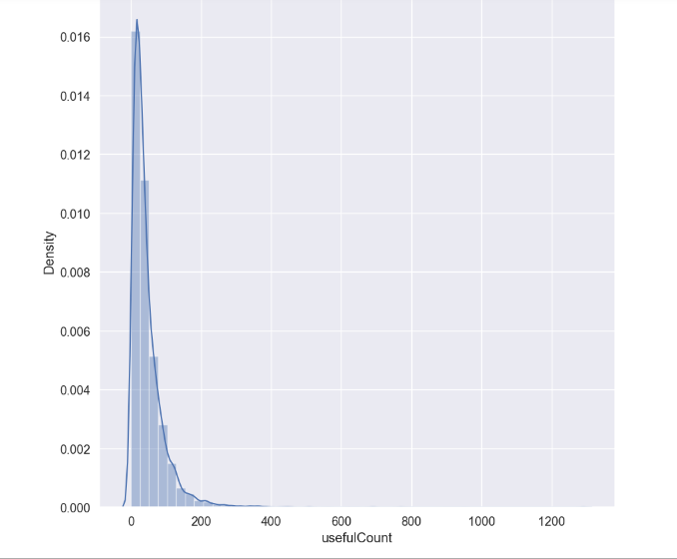
usefulCount is positively-skewed.Most of the usefulCounts are distributed between 0 and 200.
There are extreme outliers present in our usefulCounts.
We either have to remove them or transform them.

Slide 11
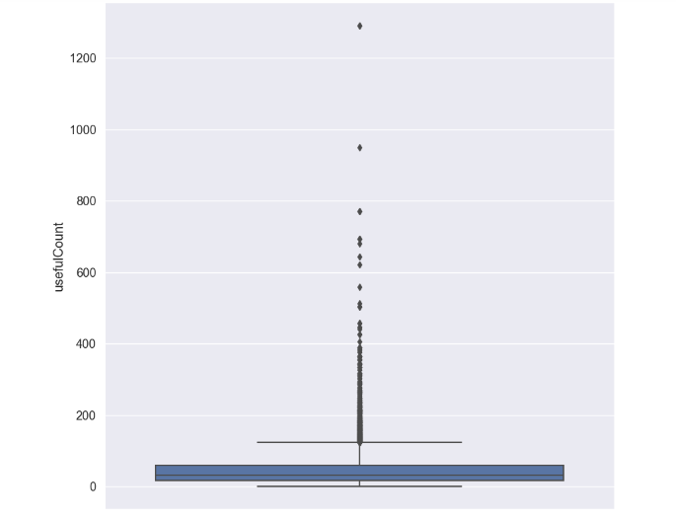
We can see that there are huge outliers present in our dataset. Some drugs have extreme useful counts.

Slide 12
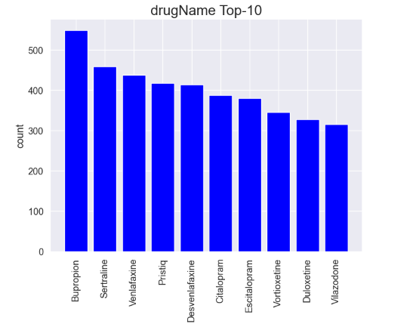
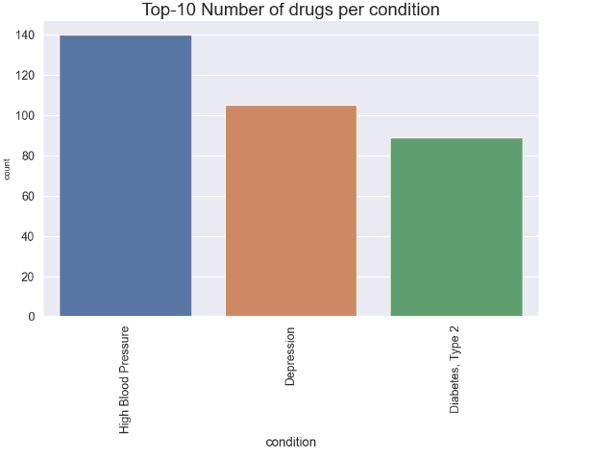
The Top drugname is Bupropion
Most of the drugnames count are around 350 if we look at top 10

Slide 13
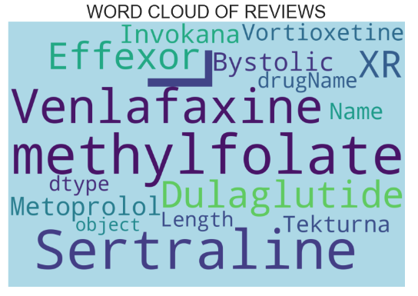
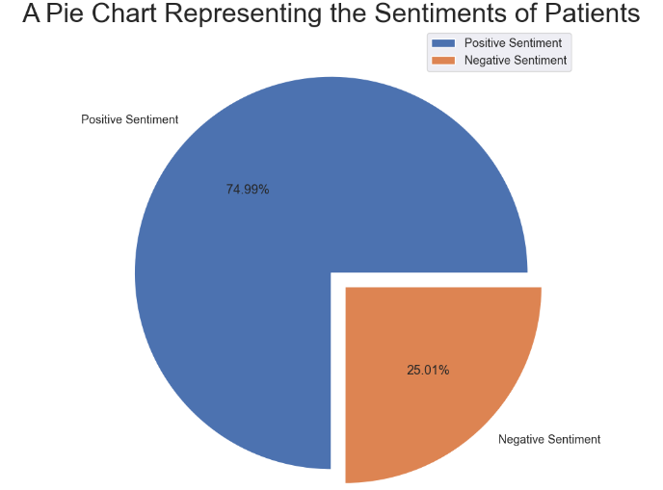

Slide 14
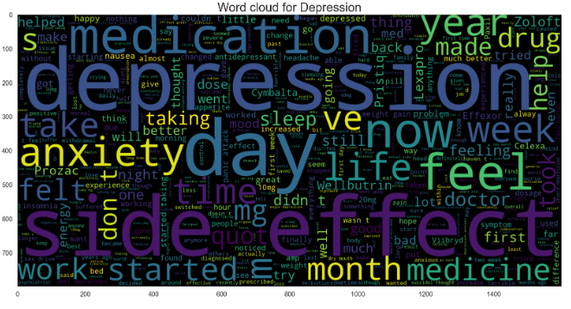
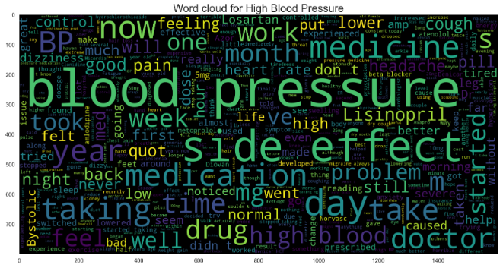
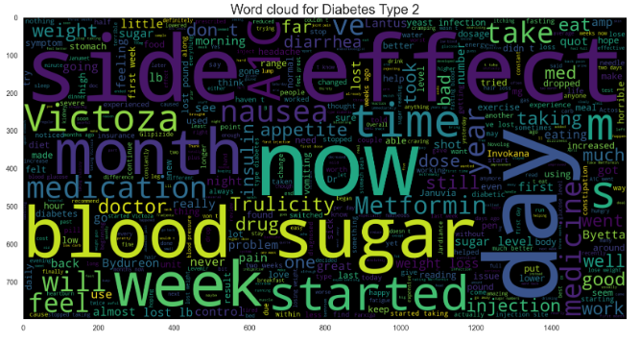

Slide 15
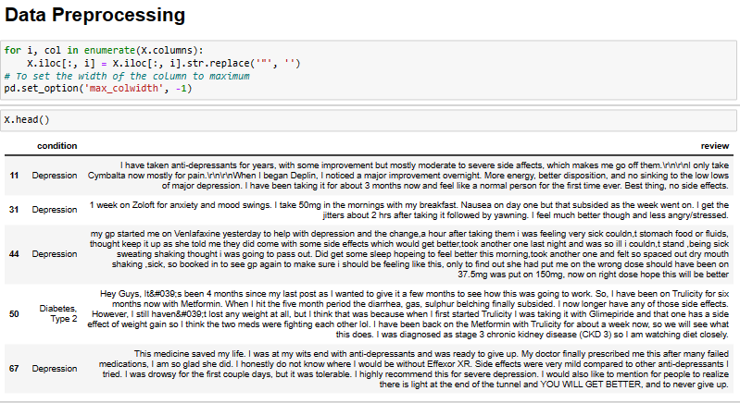
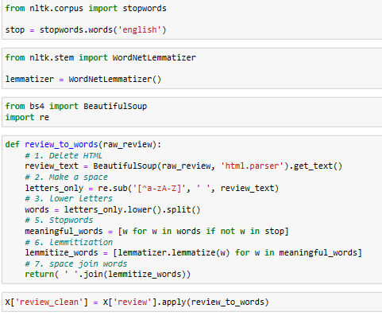
Data Pre-processing

Slide 16
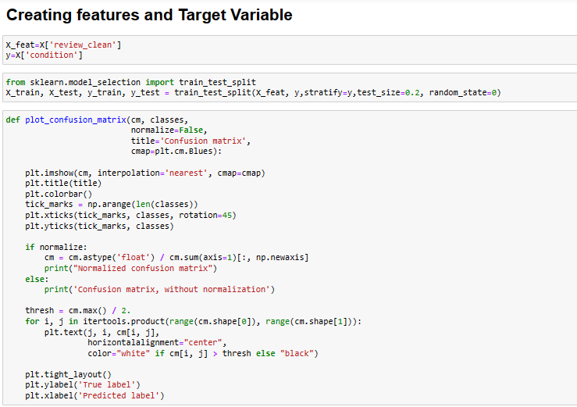
Modelling

Slide 17
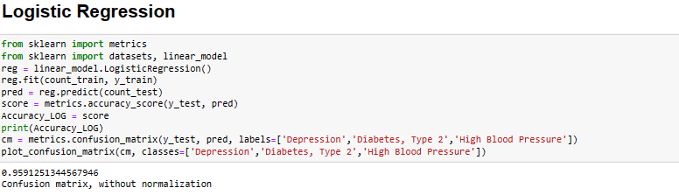
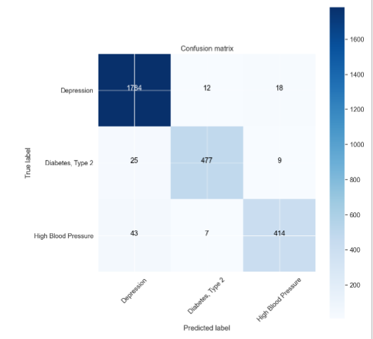
Logistic Regression

Slide 18
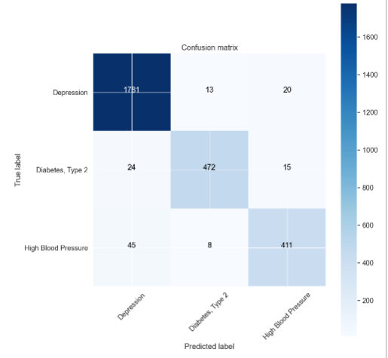
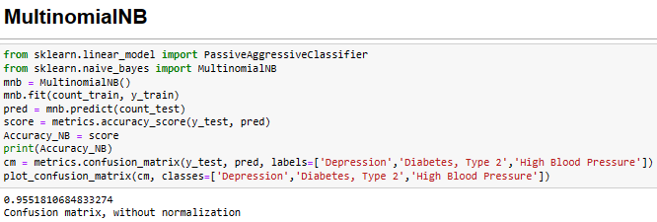
MultinomialNB

Slide 19
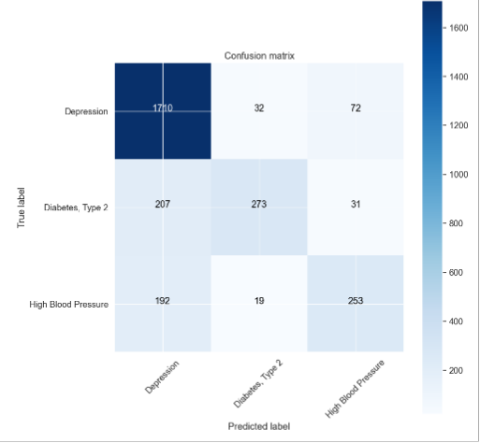
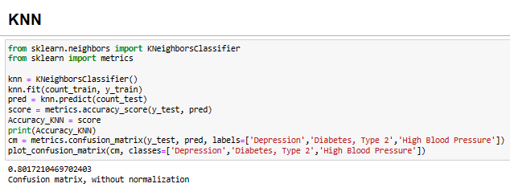
KNN

Slide 20

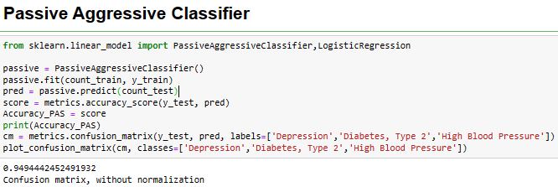
Passive Aggressive Classifier

Slide 21

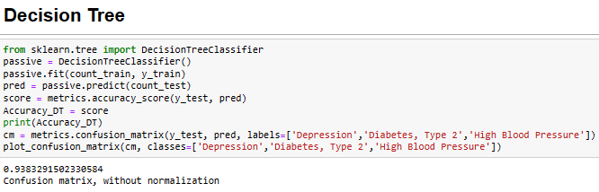
Decision Tree

Slide 22
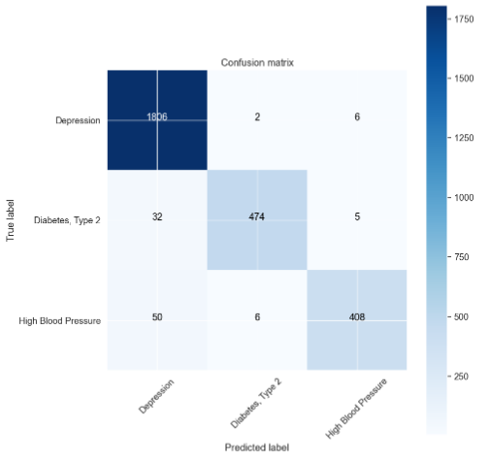
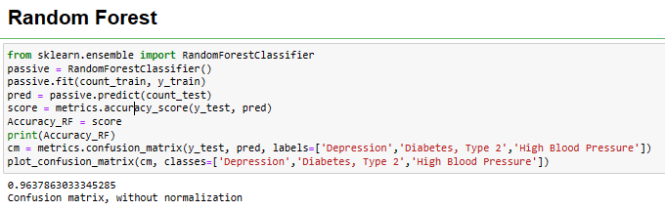
Random Forest

Slide 23
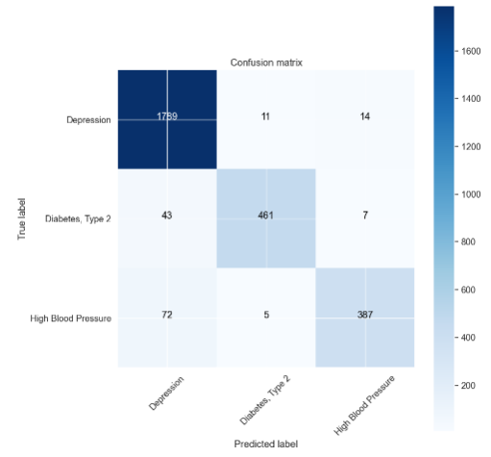
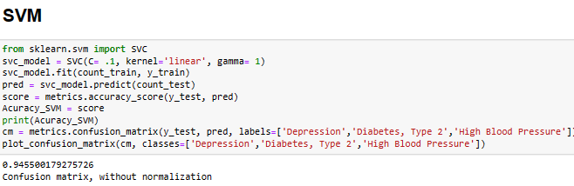
SVM

Slide 24
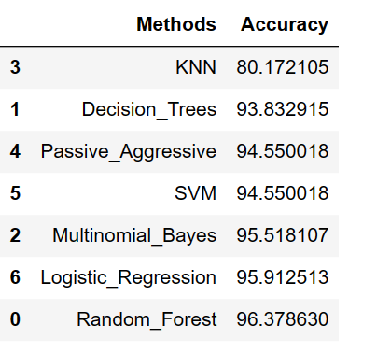
Accuracy comparison
We have achieved accuracy of 96.37% after applying RandomForestClassifier without any parameter tuning. We can tune the parameters of our classifier and improve our accuracy.

Slide 25
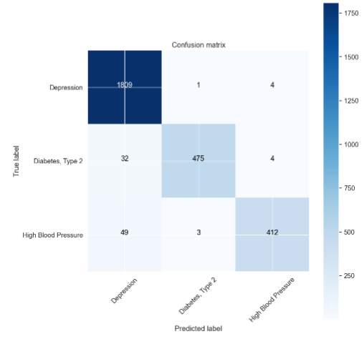
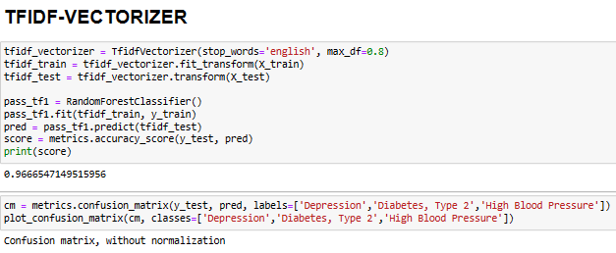
TFIDF-VECTORIZER

Slide 26
Model Deployment Using Streamlit:
https://hemantbk-classification-try-0iopqy.streamlit.app/

Slide 27


